Slide 1
MSCRM Integration (DocuSign, MK Denial, Payment Gateway, Email Integration)

Slide 2
Contents
DocuSign
MK Denial
Payment Gateway
Email Integration

Slide 3
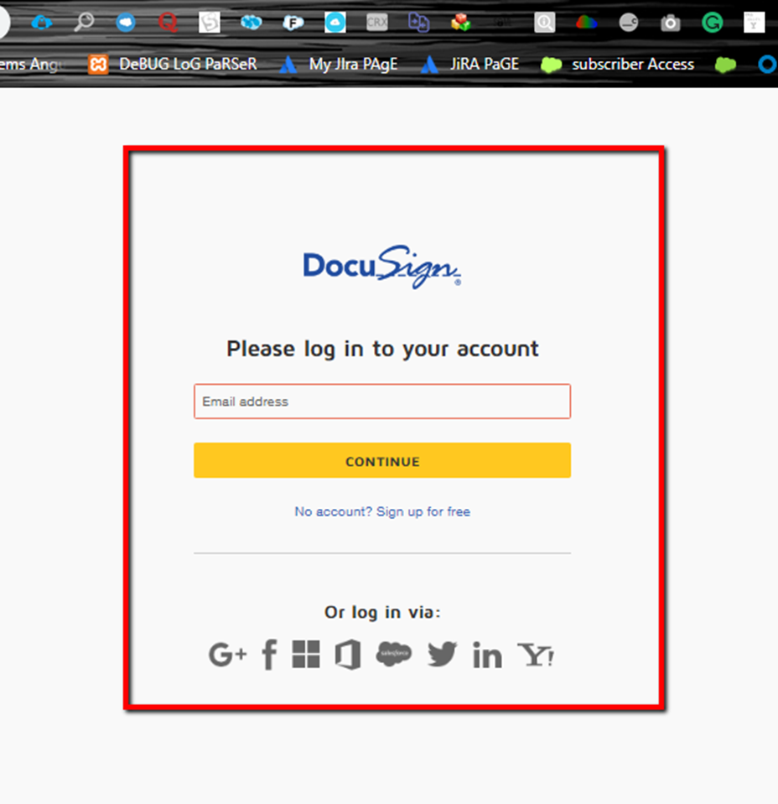
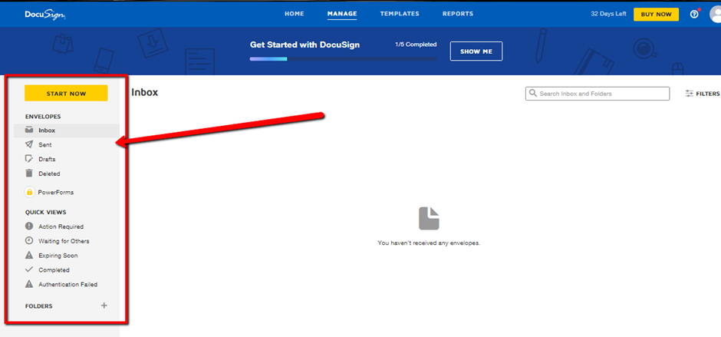
Docusign
Docusign is basically a connector which serves as a bridge between CRM and Target User’s/ Signers. This connector consists of a Managed package/ Solutions in SFDC or Microsoft CRM

Slide 4
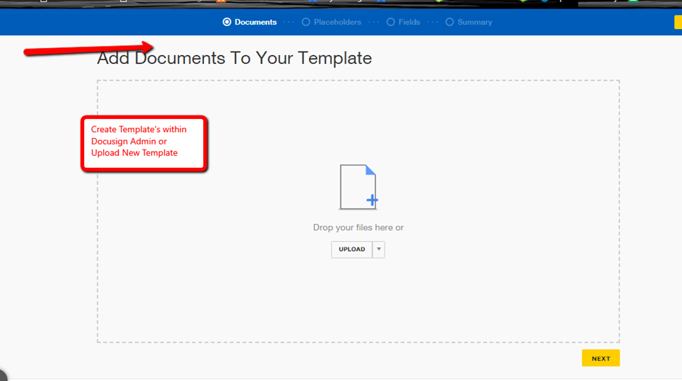
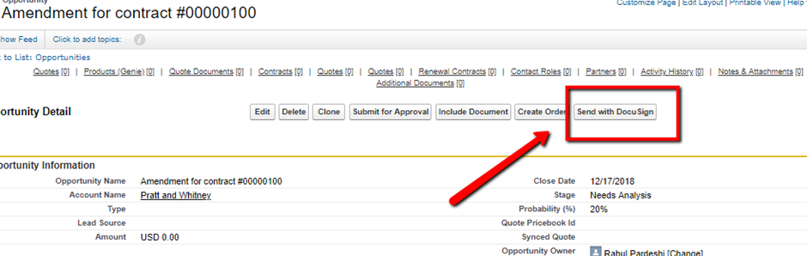
DocuSign Flow explained
User(admin User) has to have a licenses in order to access all the available components (Classes, methods, Objects) which is managed via Licenses & Permission sets in any CRM.
Account subscribing to DocuSign service gets’ an admin
Unique account # which they can access via any browser.
This DocuSign Admin account stores all the critical information- Org ID for the CRM, Account Name, Access Token
Login Screen to the Admin Guide

Slide 5
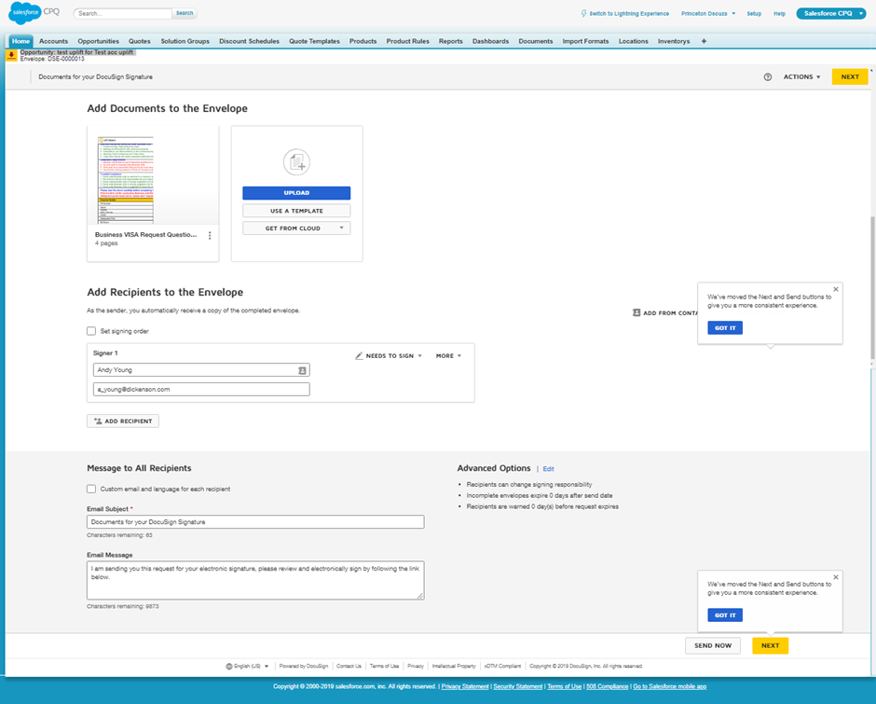
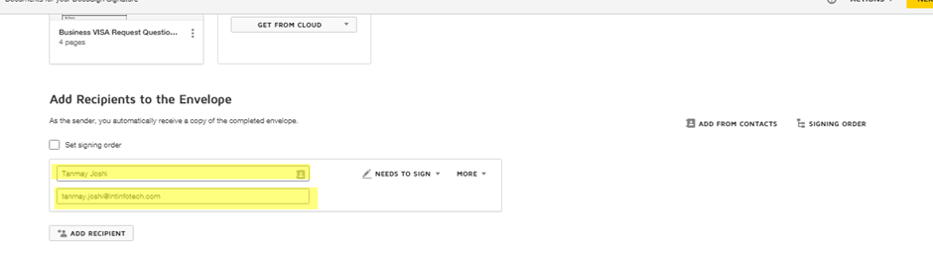
Add the account name and the user’s email address – this is prepopulated via CRM – users’ list.

Slide 6
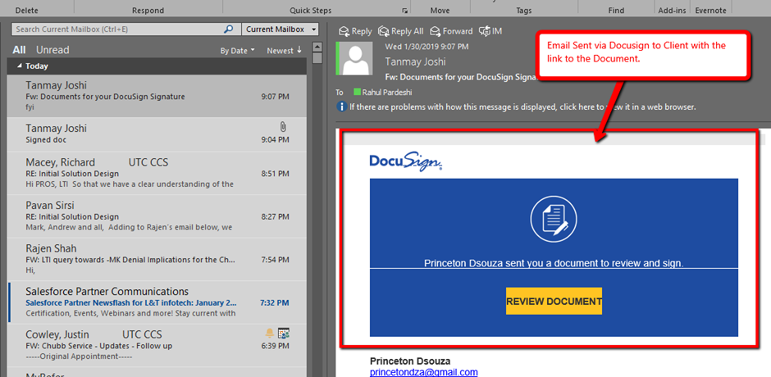
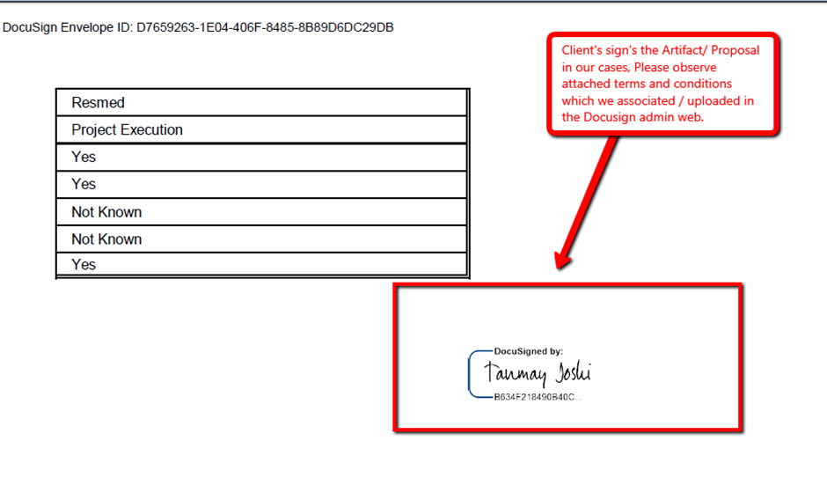
Email Received via DocuSign with the link for the document which opens’ up a document console and client gets the ability to sign the document on the fly.
Client as soon as he / she signs the document following the above link the sender’s gets a notification letting them know the document got signed.
Although, the signed document’s stays in the admin login console/ repository for DocuSign – web access. You can create a rule with the admin console which will route back the singed document to quote entity within CRM

Slide 7
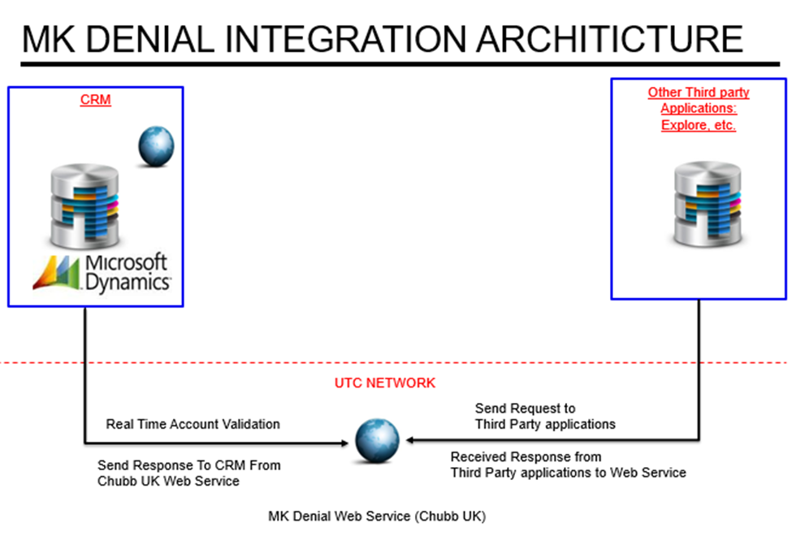
MK Denial
We invoke the logic utilized in our initial implementation for MSCRM which we utilized for Account or Contact entity with respect to MK Denial web services from CRM. We pass below given parameters from CRM to MK Denial.
Architecture

Slide 8
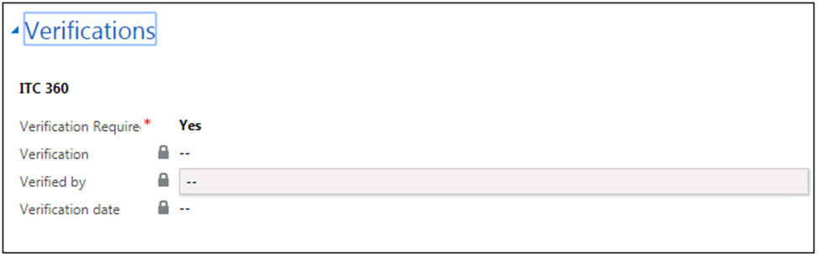
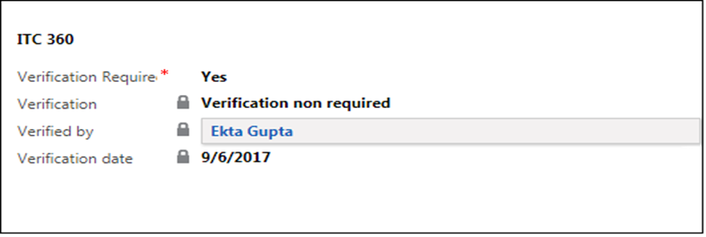
Fields on Account and Contact entities
2. MK Denial Integration executed by Clicking on below given button
3. Web Services provide response as “Verification Not Required” then below given data will get updated in CRM

Slide 9
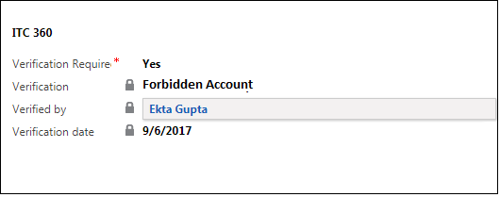
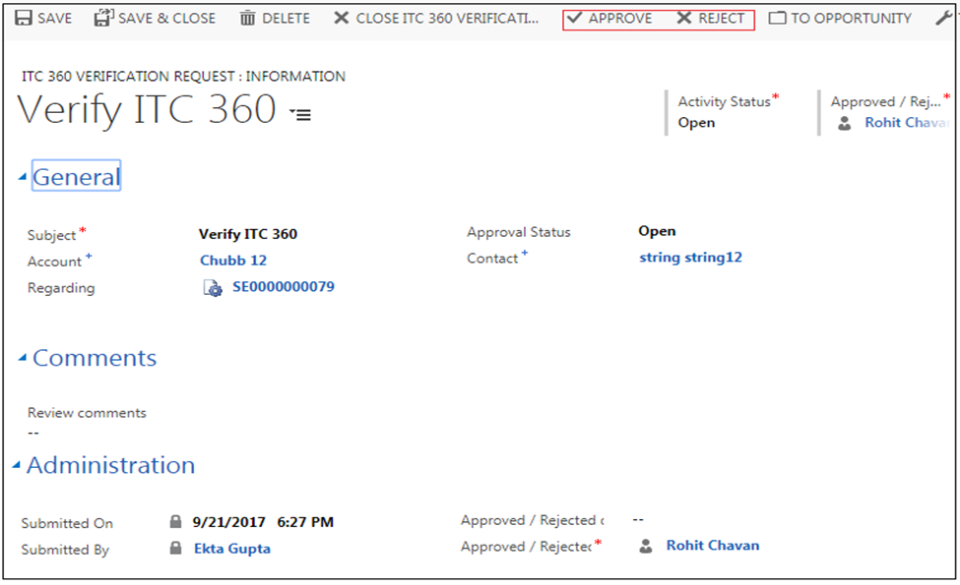
4. Web Services provide response as “Verification Forbidden” then below given data will get updated in CRM
5. If Web Services provide response as “Verification in Progress” then we create one record entry in “ITC 360 Verification Request” entity

Slide 10
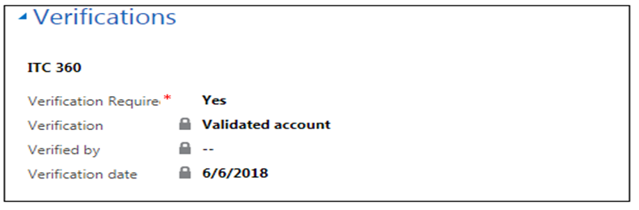

6. When Manger user click on Approve button then associated Account or Contact will get validated in CRM
7. When Manger user click on Rejected button then associated Account or Contact will get Rejected in CRM.

Slide 11
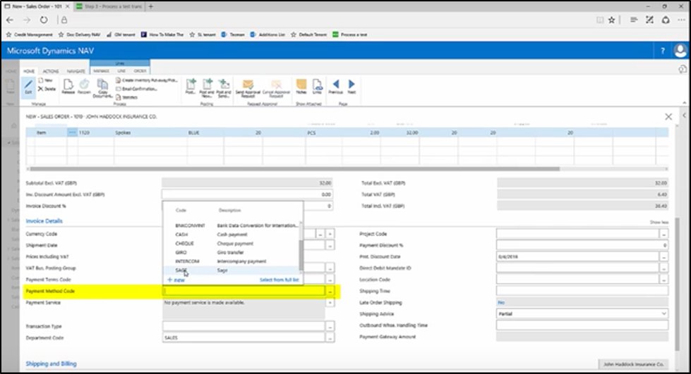
Payement Gateway
Microsoft Dynamics can seamlessly integrate with SV (Independent Service vendor) offerings- integrating with other suites and applications.
Quote, Order & custom entities can easily integrate with the available payment gateways.
For Pros Service Contract we’ll utilized the Quote entity for processing the payments via gateways.

Slide 12
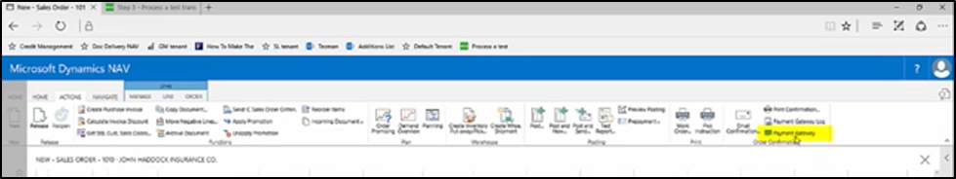
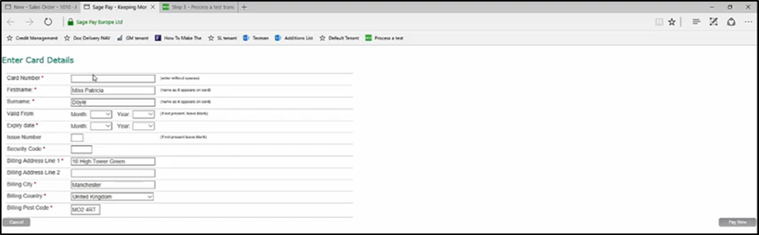
We can select any Payment Method. For Eg: SAGE/ World pay.
Select Payment Gateway
Redirected to payment Website , where the necessary details are been entered. Eg ( card number. Exp date mm/yy and etc.

Slide 13
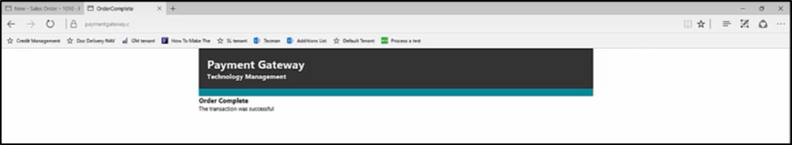
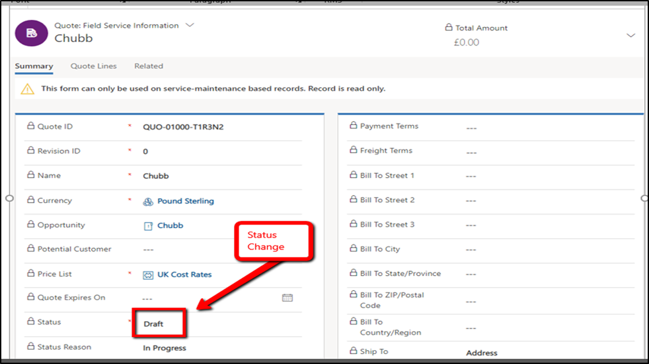
After making the payment ,message will be popped saying that the order successful.
On successful, completion for the payment the sales order /Quote will have statuses updated.

Slide 14
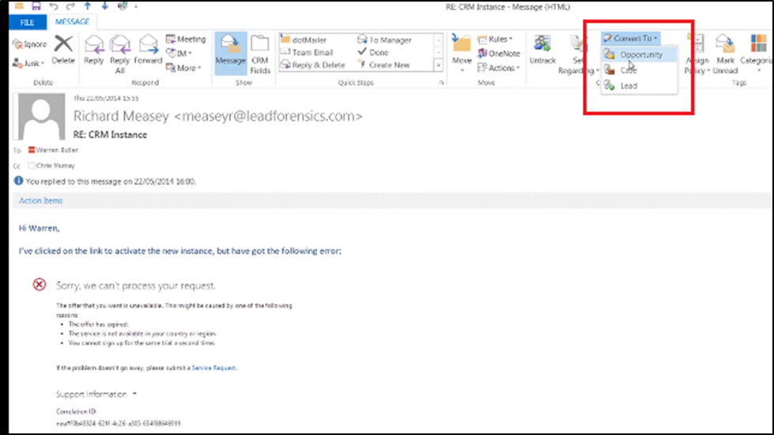
Email Integration
We can utilize the Native Emails feature for the MS CRM within MS Dynamics, to present the quote to the concern parties involved

Slide 15
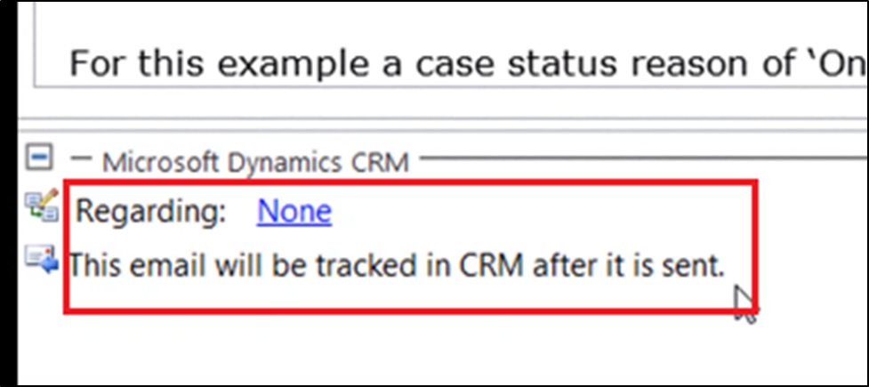
Mail been tracked

Slide 16
THANK YOU

